Slide 1
Network Visualization
ULS Digital Scholarship Workshop
Understanding Networks, Part 2
February 7, 2024
Slides available at: bit.ly/pittdss-networks2024

Slide 2

Today’s Learning Goals
Practice applying key network concepts and data visualization best practices
Gain experience with Gephi’s interface and tools for analyzing and visualizing networks
Rachel Starry
Head of Digital Scholarship Services University Library System
rachel.starry@pitt.edu

Slide 3
Your Interests?
What kinds of data or research materials do you want to explore using networks?
What disciplines are you coming from? What research questions do you want to explore?

Slide 4

What is a “network”?
Example: Six Degrees of Kevin Bacon (and The Oracle of Bacon)
“a parlor game based on the six degrees of separation or small world concept”
Kevin
Bacon
Samuel L.
Jackson
(both appear in Trapped)
Charlize
Theron
(both appear in Astro Boy)
“Kevin Bacon,” by SAGIndie from Hollywood, USA - Flickr, CC BY 2.0

Slide 5
Network Terminology
A network is made up of nodes and edges.
Kevin
Bacon
edges
Samuel L.
Jackson
nodes
Charlize
Theron

Slide 6
What is “network analysis”?
Like the idea of Hollywood actors having a “Bacon number,” there are many ways to calculate the importance of nodes and to quantify the complex relationships between nodes.
Kevin
Bacon
Samuel L.
Jackson
Charlize
Theron

Slide 7
What is network analysis?
Some questions we can ask:
1. What are the most “important” nodes in my network?
2. How strongly connected is my network?
3. Are there detectable groups or communities of nodes in my network?
Three common methods:
Calculating network centrality (identifying the most “important” nodes in a network)
Calculating network density (the shape and overall connectedness of a network)
Calculating network modularity (whether nodes cluster into communities)

Slide 8
Network Centrality
or, “what are the most important nodes in my network?”

Slide 9
Network Centrality
Definition: measurement indicating the most important nodes
issue: what does “important” mean?

Slide 10
Network Centrality
Four kinds:
Degree centrality
Betweenness centrality
Closeness centrality
Eigenvector centrality

Slide 11
Degree Centrality
Four kinds:
Degree centrality: measures the sum of each node’s connections
Betweenness centrality
Closeness centrality
Eigenvector centrality

Slide 12
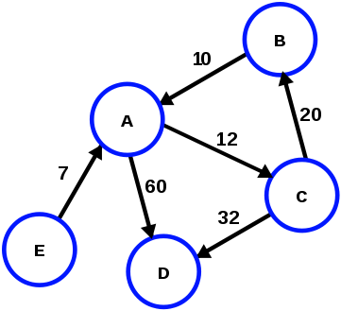
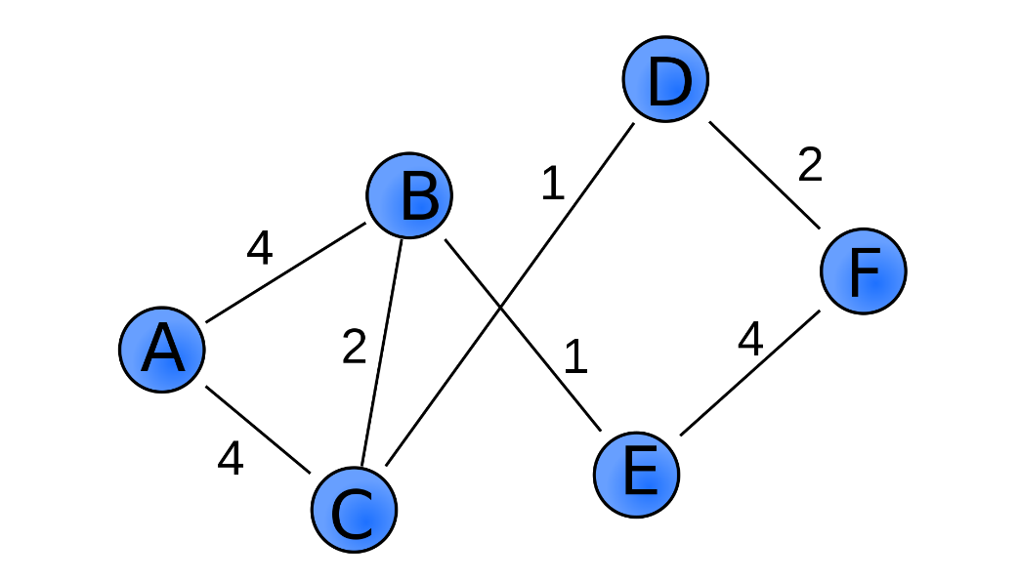
Degree Centrality
Weighted degree: combining edge weight with degree
Directed degrees: combining edge direction with degree (in-degree and out-degree)
Directed (and
weighted) graph
Weighted graph
“directed weighted graph,”
by Pluke, Wikimedia Commons, CC 0
“Weighted Graph,” by Pk0001, Wikimedia Commons, CC 0

Slide 13
Betweenness Centrality
Four kinds:
Degree centrality
Betweenness centrality: how many “shortest paths” across the network lead through each node
Closeness centrality
Eigenvector centrality

Slide 14
Closeness Centrality
Four kinds:
Degree centrality
Betweenness centrality
Closeness centrality: average length of the “shortest path” between a given node and all other nodes in the network
Eigenvector centrality

Slide 15
Eigenvector Centrality
Four kinds:
Degree centrality
Betweenness centrality
Closeness centrality
Eigenvector centrality: measures each node’s connection to other highly connected nodes (extension of degree centrality)

Slide 16
2. Network Density
or, “how strongly connected is my network?”

Slide 17
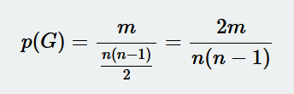
Network Density
Definition: measurement indicating the percentage of potential connections that actually exist among nodes in a network
Network-level measurement
for a network G made of n nodes and m edges:
number of edges in network
number of possible edges in network

Slide 18
3. Network Modularity
or, “are there detectable communities in my network?”

Slide 19
Network Modularity
Definition: calculation that identifies communities (“modularity classes”) in a network
Network-level measurement

Slide 20
Network Modularity
Example: Predicting communities – Belgian mobile call network
Caveats:
Doesn’t work (well) with weighted graphs
Doesn’t work (well) with directed graphs
In directed graphs, the edge direction significantly affects how a node (and community) is connected to rest of network
See also: Interactive Python notebook comparing community-detection algorithms for another famous dataset (Zachary’s Karate club)

Slide 21
Data Visualization
Best Practices

Slide 22
What is data visualization?
Exploratory visualization: making sense of your data
Turning over 100 rocks to find 1 or 2 gems
Explanatory visualization: sharing information with an audience
Telling a story about those 1 or 2 gems
Source: Storytelling with Data by Cole Nussbaumer Knaflic (http://www.storytellingwithdata.com/blog/2014/04/exploratory-vs-explanatory-analysis)

Slide 23
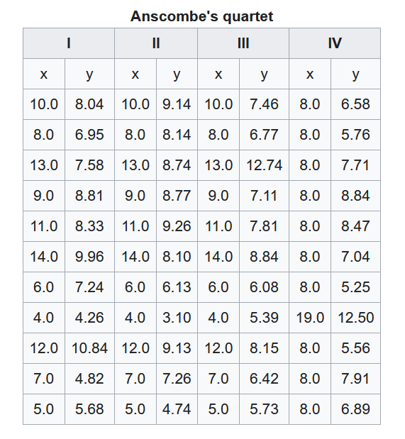
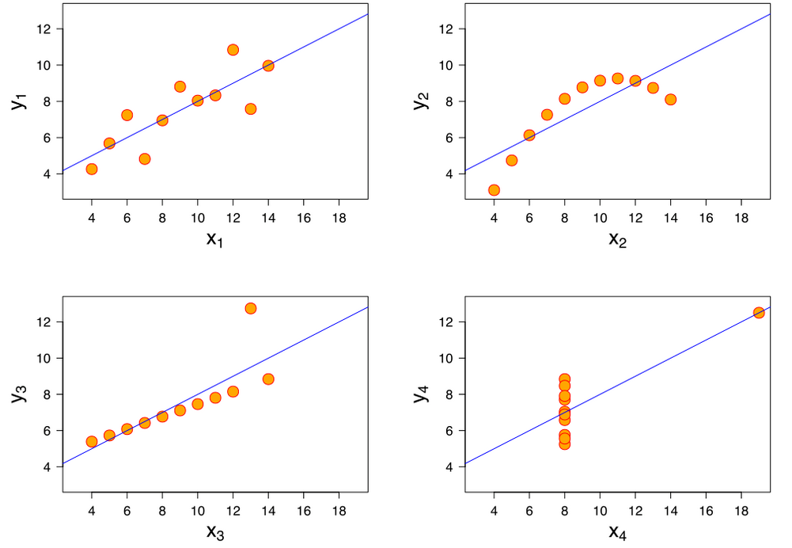
Source: Anscombe’s Quartet (Wikipedia);
Anscombe.svg by Schultz, CC BY-SA 3.0 (Wikimedia Commons)

Slide 24
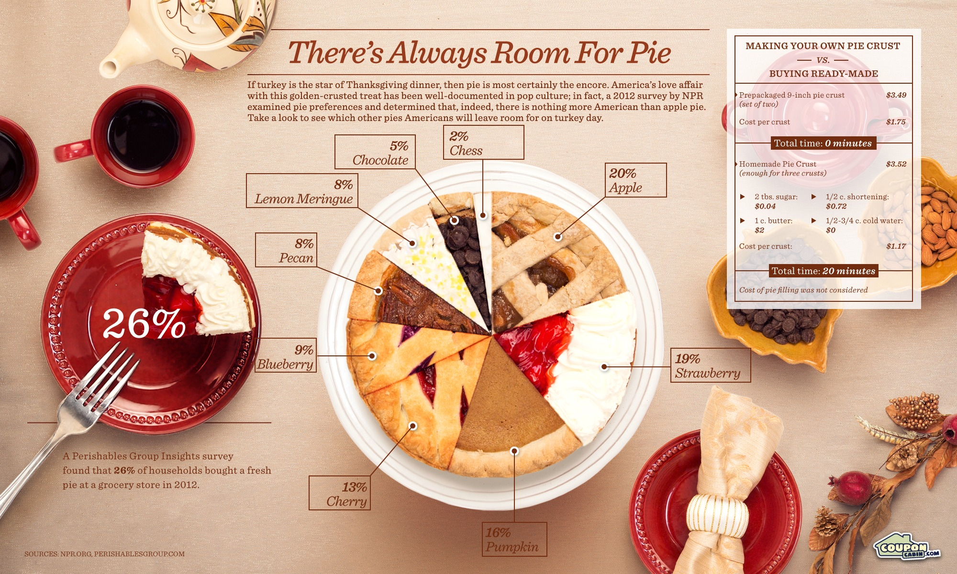
Source: Huffington Post

Slide 25
Using color in network visualizations
Color scales: for sequential data
in Gephi – coloring nodes by “ranking”
Color palettes: for categorical data
in Gephi – coloring nodes by “partition”

Slide 26
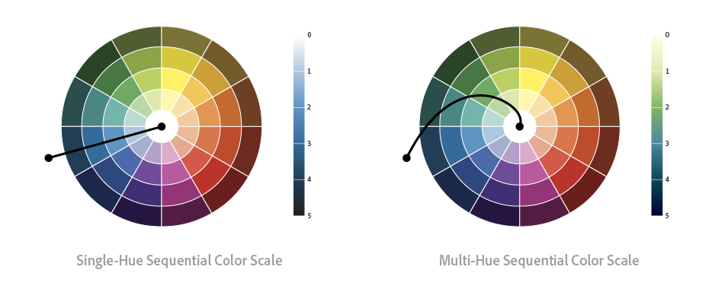
Color scales: for sequential data (example)
Source: Alan Wilson (2017), “The Power of the Palette,” Adobe Blog

Slide 27
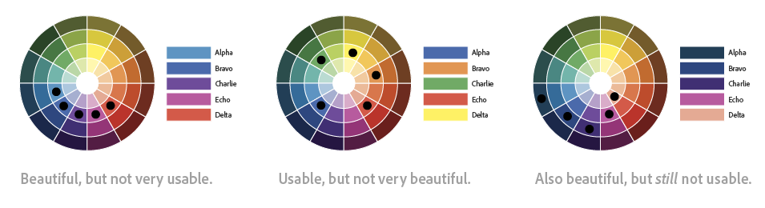
Color palettes: for categorical data (example)
Source: Alan Wilson (2017), “The Power of the Palette,” Adobe Blog

Slide 28
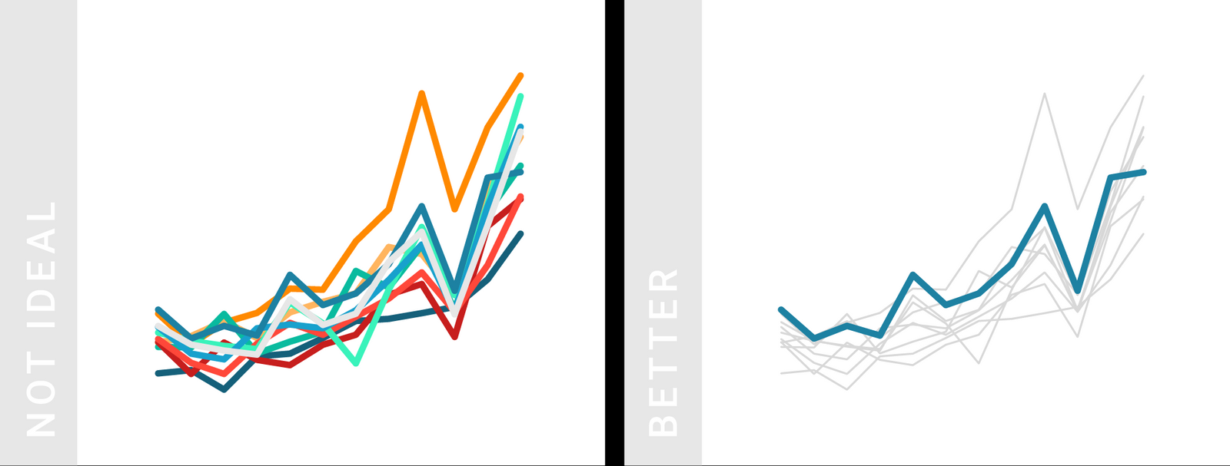
Design principles for color
Things to consider:
Grey is a very useful color!
Source: Lisa Charlotte Rost (2018), “What to consider when choosing colors for data visualization,” Chartable

Slide 29
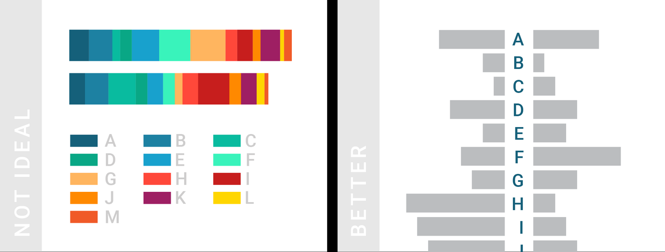
Design principles for color
Things to consider:
How many different colors are necessary? (ideally, < 7)
Source: Lisa Charlotte Rost (2018), “What to consider when choosing colors for data visualization,” Chartable

Slide 30
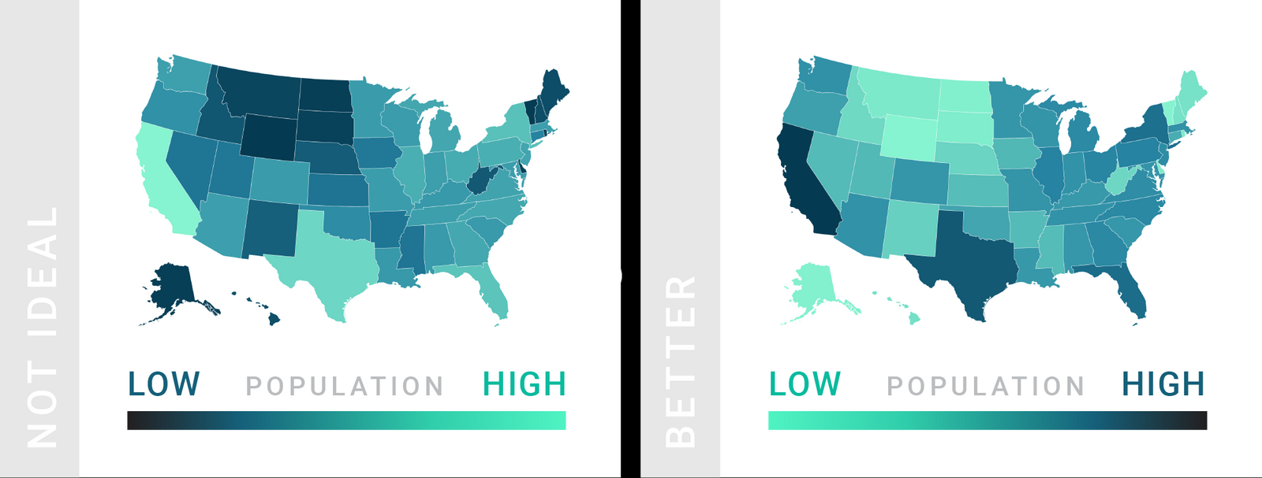
Design principles for color
Things to consider:
Follow established standards: dark colors for high values, light colors for low values
Source: Lisa Charlotte Rost (2018), “What to consider when choosing colors for data visualization,” Chartable

Slide 31
Choosing visually accessible colors
VizPalette: projects.susielu.com/viz-palette

Slide 32
Goals of customizing network appearance
The primary goal of an exploratory network visualization is to uncover patterns for you to explore further.
The primary goal of an explanatory network visualization is to make a readable representation of your network or the specific patterns/findings you want to communicate to readers.

Slide 33
Recommendations for network visualizations
Be intentional about how you map variables to node and/or edge appearance.
Document your exploratory visualization process. (both for later reproducing graphs and tracking the patterns you discover through exploratory visualization)
Save your network data separately from your visualizations. (save entire project as .gephi AND export data as .csv or .gml AND export graphs as .svg or .png)

Slide 34
Gephi Walkthrough

Slide 35
Gephi
“The Open Graph Viz Platform” gephi.org
Benefits of using Gephi for network analysis:
Free and open-source
Robust user community
Lots of plugins to extend functionality
Built-in calculations for centrality, density, and modularity
Import and export network data easily

Slide 36
Network Data
Gephi requires two files to create a network graph:
A list of nodes
A list of edges

Slide 37
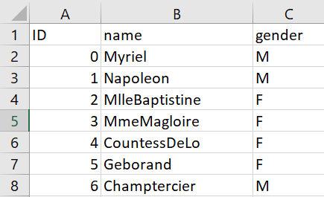
Network Data
Node lists require two attributes/columns:
List of objects (“name”)
List of unique identifiers (“ID”)
Optional: other attributes describing your nodes

Slide 38
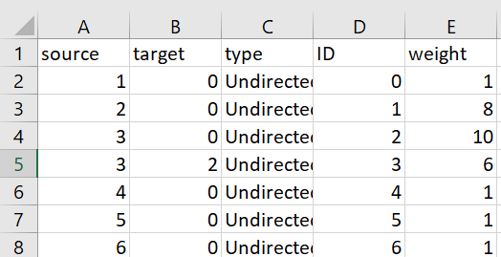
Network Data
Edge lists require two attributes/columns:
List of “source” nodes
List of “target” nodes
Optional: type (should be “directed” or “undirected”), weight

Slide 39
Gephi Walkthrough
Navigate to bit.ly/pittdss-networks2024 and download the repository as a .zip file.
Option #1: create a network graph from node and edge lists
Use the node and edge lists (.csv files) in the “Les Miserables Character Relationships” folder
Option #2: open a network graph file (in a supported file format)
Use any of the 4 example .gml or .graphml files from the repository

Slide 40
Gephi Walkthrough
Visualization steps:
Run network statistics
Apply a layout algorithm
Customize node appearance
Customize edge appearance
Repeat as needed
Remember to document your process as you go!

Slide 41
Tutorials and Resources
Gephi Tutorials:
Martin Grandjean, “Gephi Introduction”
Clément Levallois, “Simple Gephi Project from A to Z”
Gephi.org tutorials
Network Analysis Learning Resources:
Albert-László Barabási, “Network Science” (open textbook)
Scott Weingart, “Demystifying Networks” (digital humanities approaches)
Sources for Network Datasets:
Gephi wiki, datasets
Stanford Large Network Dataset Collection
François Briatte’s curated list of network datasets

Slide 42
Workshop Follow-up
Additional questions?
library.pitt.edu/ask-us
or send DSS an email at ULS-DigitalScholarshipServices@pitt.edu
Slides: bit.ly/pittdss-networks2024

